Slide 1
ge1155
Computer in Education
Lecturer: Dr. Fariza Binti Khalid

Slide 2
Implication of Web 2.0 in Education
Muhammad Afifie Bin Mohamad Sukri (A154354)
Muhammad Hilmi Bin Yaacob (A154997)
Mohamad Nazrol Hisyam Bin Abdullah (A155120)

Slide 3
Definition of Web 2.0

Slide 4
Definition
Term given to describe a second generation of the World Wide Web that is focused on the ability for people to collaborate and share information online.
Web 2.0 basically refers to the transition from static HTML Web pages to a more dynamic Web that is more organized and is based on serving web application to users. (Oxford Dictionary)

Slide 5
Definition
Web 2.0 describes World Wide Web sites that emphasize user-generated content, usability, and interoperability (Tim O'Reilly and Dale Dougherty , 2004)

Slide 6
Examples of Web 2.0

Slide 7
Categories, examples and function of web 2.0
Categories | Examples | Function
Social networking site | Facebook | Discussion and sharing of teaching tools
Blog | Wordpress | Archive of all teaching materials and student reflection
Video networking site | Youtube | Presentation and video sharing
Micro blog | Twitter | Discussions, forums and information consignment
Presentation equipment | Prezi | Presentations

Slide 8
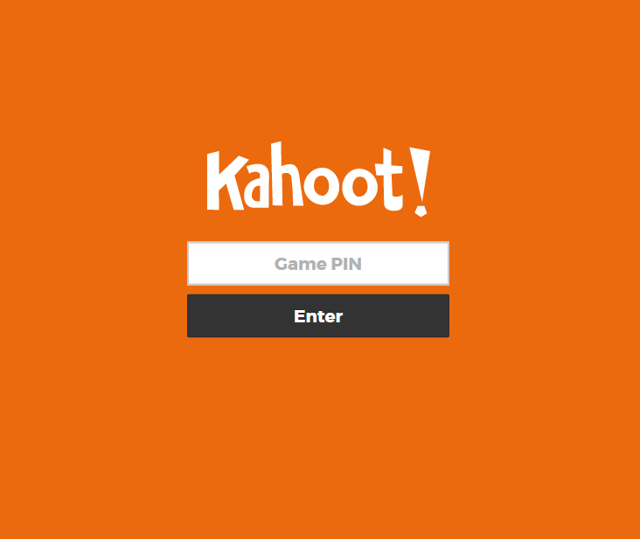
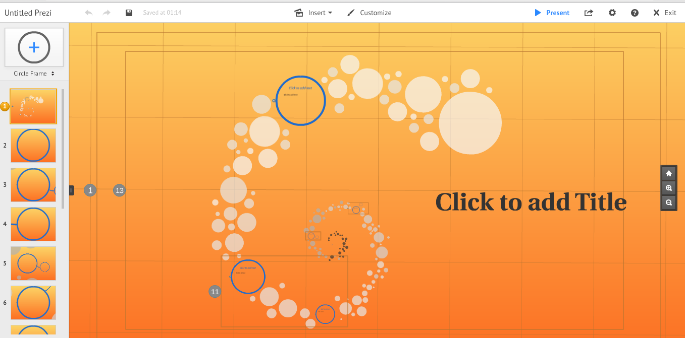

Slide 9
EXAMPLES OF WEB 2.0 ‘tools’
Blogs Facebook
Wikis MySpace
Youtube Flickr
social bookmarking Twitter
podcasts Skype
webcasts

Slide 10
Benefits of using Web 2.0

Slide 11
Benefits of Using WEB 2.0 IN TEACHING
Helps build a sense of community
Increases interaction and communication among the instructor, students, and other people.
Promotes collaboration and resource sharing

Slide 12
Benefits of Using WEB 2.0 IN TEACHING
Knowledge creation
Ease of use and flexibility
Writing and technology skills

Slide 13
Benefits of Using WEB 2.0 IN TEACHING
Motivation
Community Building
Familiarity

Slide 14
Barriers of using web 2.0

Slide 15
Barriers of using web 2.0 in teaching
Uneasiness with openness
Technical Problem
Time Consuming

Slide 16
Tips & Tricks

Slide 17
web 2.0 in teaching (Tips & Tricks)
Do NOT introduce too many new technologies to students in one semester
Do NOT use multiple technologies that do the same thing
Provide appropriate instruction, tutorials, examples, and frequent feedback

Slide 18
THANK YOU

